Slide 1

History Curriculum Overview
All Saints CE Primary School
Whitefield, Bury

Slide 2
History Overview
 | Year 1 | Year 2 | Year 3 | Year 4 | Year 5 | Year 6
Autumn | What was life like for our grandparents when they were children? | What do we know about the Victorians? | How did Britain change between the beginning of the Stone age and the end of the Iron age? | How did Britain change between the end of the Iron age and the end of the Roman occupation? | What did the Ancient Greeks bring to the world? | What impact did WW1 and WW2 have on ordinary people in your local area?
Spring | Who were and are the famous Manchester people? | What lessons have we learned from the Great Fire of London? | Why were the Ancient Mayans the envy of the world? | How advanced were the famous civilizations that were great 3000 years go? | What do we know about the history of Manchester? | Why should gunpowder, treason and plot never been forgotten?
Summer | How have our homes changed over time? | Which black people have influenced our lives today? | Why does Bury exist in the first place? | What does it mean to be a slave? | How did Britain change between the end of the Roman occupation and 1066? | What was the impact of immigration on Britain over the past 70 years?

Slide 3
Historical Knowledge and Skills
Chronology & Causation
To ensure the pupils have a coherent narrative, knowledge and understanding of Britain’s past and the wider world from the earliest times to the present day, how people’s lives have shaped Britain and how Britain has influenced and been influenced by the wider world.
EYFS | Year 1 | Year 2
To appreciate the difference between old and dirty or worn To know the difference between old and new To know the difference between long ago and now To be able to compare old and new objects/ artefacts be able to put up to two artefacts or events in order To begin to appreciate that their life is different to the lives of people in the past To understand the past through settings, characters and events encountered in books read in class and storytelling Use words like yesterday, last week, old and new | To appreciate the difference between long ago and very long ago Create a simple timeline to capture recent events Remember parts of stories they have read or have had read to them which involve memories about the past Know that the toys their parents and grandparents played with were different to their own Organise a number of artefacts by age Recognise that familiar objects we have today would have been different in the past, i.e., telephone Know what a number of older objects were used for Know the main differences between their school days and that of their grandparents Begin to appreciate what a timeline is by looking at a time line over the past 10 years Use words to show the passing of time: old, new, earliest, latest, past, present, future, century, new, newest, oldest, modern, before, after | Recognise that stories they have read help them understand about the differences that exists between the place they live in and places in the past Describe memories and changes that have happened in their own lives Begin to appreciate the difference between long ago and very long ago Know where the people and events studied fit into a basic timeline Able to point out a few similarities and differences between ways of life at different times Able to order a few events and artefacts from the recent past Use words and phrases such as: old, new, earliest, latest, past, present, future, century, new, newest, old, oldest, modern, before, after to show the passing of time

Slide 4
Historical Knowledge and Skills
Chronology & Causation: 2
Year 3 | Year 4 | Year 5 | Year 6
Begin to understand that the past is divided into different named periods of time Able to use dates to explain British, local and world history Start using a timeline that identifies different centuries Use appropriate dates and chronological conventions, e.g., BC, BCE and AD Put artefacts or information in chronological order from a long time ago Understand that significant discoveries or inventions created much change to the lives of people, e.g. the wheel or iron ore | To be able to place events, people and changes of British, local and world history on a timeline To accurately set out different events onto a timeline To appreciate that some major events in the past caused a major change to the British landscape, e.g., Roman occupation Sequence several events, artefacts or historical figures on a timeline using dates, including those that are sometimes further apart Know how to use the timeline in relation to the unit being studied. Use words and phrases: century, decade Know how some historical events/periods occurred concurrently in different locations, e.g. Indus Valley and Ancient Egypt. | To have a secure understanding of a British timeline that extends from the Stone Age to the present day To show a chronologically secure knowledge and understanding of local, national and global history To be able to tell the story of events within and across the time periods studied To describe connections. contrasts and trends over short and longer time periods Order an increasing number of significant events, movements and dates on a timeline using dates accurately; Accurately use dates and terms to describe historical events; Know and describe in some detail the main changes to an aspect in a period of history being studied | To demonstrate a coherent chronological narrative, knowledge and understanding of Britain’s past and the wider world To identify specific changes within and across different periods over a long period of history Use timelines to place events, periods and cultural movements from around the world. Use timelines to demonstrate changes and developments in culture, technology, religion and society. Use these key periods as reference points: BC, AD Romans, Anglo-Saxons, Tudors, Stuarts, Georgians, Victorians and Today. Describe main changes in a period in history using words such as: social, religious, political, technological and cultural. Name date of any significant event studied from past and place it correctly on a timeline

Slide 5
Historical Knowledge and Skills
Historical Enquiry
EYFS | Year 1 | Year 2
Ask questions or make remarks about illustrations in a book they are reading which may be set in the past Begin to recognise that characters in a book they know acted as they did because it was a long time ago | Respond to simple questions about the past Observe and handle artefacts and ask simple questions about the past Offer an opinion as to why something may have happened in the past and why they know | Look carefully at pictures and objects to find information. Find answers and respond to simple questions about the past. Choose and select evidence and say how it can be used to find out about the past Understand some ways we find out about the past Recognise the importance of basing ideas on evidence Develop the idea of presenting an idea and raising questions about the past

Slide 6
Historical Knowledge and Skills
Historical Enquiry: 2
Year 3 | Year 4 | Year 5 | Year 6
Use a variety of sources to collect information about the past Suggest sources of evidence from a selection to help answer questions and says how it can be used to find out about the past Explain that there are different types of evidence and sources that can be used to help represent the past | Know the difference between primary and secondary sources of evidence Use a range of sources to collect information about the past Construct informed responses about one aspect of life | Recognise when they are using primary and secondary sources of information to investigate the past Select relevant sections of information to address historically valid questions and construct detailed, informed responses Use a wide range of different evidence to collect evidence about the past To be able to devise questions about change, cause and consequences, similarity, difference and significant people or events in a wider context | Use a wide range of different evidence to collect evidence about the past, such as ceramics, pictures, documents, printed sources, posters, online material, pictures, photographs, artefacts, historic statues, figures, sculptures, historic sites Investigate own lines of enquiry by posing historically valid questions to answer To understand the complexity of people’s lives in the past and how some societies are different due to changes and challenges at that time

Slide 7
Historical Knowledge and Skills
Historical Significance & Interpretation
EYFS | Year 1 | Year 2
Know that many of the things we use today would have been different in the past To give a reason for why something has changed between now and the past To look at or touch objects from the past and comment on appearance To recognise that the past is different from today | To identify similarities and differences between different times Begin to identify and recount historic details from the past from sources e.g. pictures/stories To begin to understand that an invention can sometime have a positive impact on an artefact we use everyday, for example, television To be able to talk about some people and events that they have studied and give reasons for their actions Consider the differences between ‘long ago’ and ‘now’ | Know about people in the past who have contributed to national and international achievements Recount historic details from eye-witness accounts, photos and artefacts To begin to reflect on the significance of what has been learnt from the past To develop an awareness of the past and comment on how they found out

Slide 8
Historical Knowledge and Skills
Historical Significance and Interpretation: 2
Year 3 | Year 4 | Year 5 | Year 6
Able to recognise the reasons someone may have acted as they did in relation to the main events and changes of a time studied Start to compare two versions of a past event Observe and use pictures, photographs and artefacts to find out about the past Start to use stories or accounts to distinguish between fact and fiction Explain that there are different types of evidence and sources that can be used to help represent the past | Look at more than two versions of the same event or story in history and identifies differences Investigate different accounts of historical events and explain some of the reasons why the accounts may be different To begin to talk about the impact of a past action on our lives today To be able to talk about similarities and differences between different times in the past according to the periods of history studied | Find and analyse a wide range of evidence about the past Use a range of evidence to offer some clear reasons for different interpretations of events, linking this to factual understanding about the past Consider different ways of checking the accuracy of interpretations of the past; Realise that there is often not a single answer to historical questions To be able to discuss trends over time To see the relationship between different periods and the legacy or impacts for people today | Find and analyse a wide range of evidence about the past Use a range of evidence to offer some clear reasons for different interpretations of events, linking this to factual understanding about the past Consider different ways of checking the accuracy of interpretations of the past Start to know the difference between primary and secondary evidence and the impact of this on reliability Show an awareness of the concept of propaganda Know that people in the past represent events or ideas in a way that may be to persuade others Begin to evaluate the usefulness of different sources Form own opinions about historical events from a range of sources

Slide 9
Long-term overview for HISTORY
YEAR 1
What was life like for our grandparents when they were children?
Know what our grandparents’ toys were like
Know how different our grandparents’ school days were
Know how our grandparents used to shop
Know what our grandparents would have eaten
Know how grandparents celebrated their birthdays or enjoyed holidays
Chronology & Causation | Historical Enquiry | Interpretation & Significance
To appreciate the difference between long ago and very long ago Create a simple timeline to capture recent events Remember parts of stories they have read or have had read to them which involve memories about the past Know that the toys their parents and grandparents played with were different to their own Organise a number of artefacts by age Recognise that familiar objects we have today would have been different in the past, i.e., telephone Know what a number of older objects were used for Know the main differences between their school days and that of their grandparents Begins to appreciate what a timeline is by looking at a time line over the past 10 years Use words to show the passing of time: old, new, earliest, latest, past, present, future, century, new, newest, oldest, modern, before, after | Respond to simple questions about the past Observe and handle artefacts and ask simple questions about the past Offer an opinion as to why something may have happened in the past and why they know | To identify similarities and differences between different times Begin to identify and recount historic details from the past from sources e.g. pictures/stories Consider the differences between ‘long ago’ and ‘now’

Slide 10

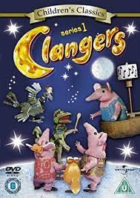
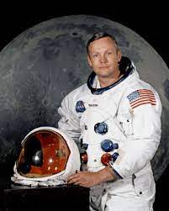

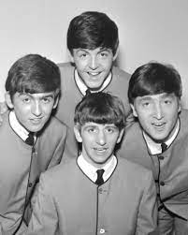

Knowledge Organiser
Year 1
Subject: History Main Learning: Chronology (Grandparents’ childhood)
Key knowledge
Know how different their grandparents’ childhood was compared to their own
Know what their grandparents’ toys were like
Know how different their grandparents’ school days were
Know how their grandparents used to shop
Know what their grandparents would have eaten
Know how grandparents celebrated their birthdays or enjoyed holidays
Vocabulary
Beatles | A very popular group through the 1960s and 1970s. Perhaps Britain’s most famous band ever.
Hippie | A name used to describe people who dressed in a very trendy way
Clangers | A very popular TV programme for children in the 1960s and 70s.
Crackerjack | Another very popular children’s programme that was on BBC on Friday nights. Famous for a quiz where children had a cabbage
Moon landing | The first man landed on the moon in 1968. He was called Neil Armstrong
McDonalds | The first McDonald’s opened in England in 1974
 | Prior Knowledge –

Slide 11
Long-term overview for HISTORY
YEAR 1
Who were and are the famous Manchester people?
Know what we mean by the term ‘famous’
Know about famous people form the past who lived locally
Know about the impact of a local famous person on our lives today
Know about a famous person from the UK that has made a difference to people’s lives
Know about someone famous from your area that is still alive today
Chronology & Causation | Historical Enquiry | Interpretation & Significance
Create a simple timeline to capture recent events Remember parts of stories they have read or have had read to them which involve memories about the past Begin to appreciate what a timeline is by looking at a time line over the past 10 years Use words to show the passing of time: old, new, earliest, latest, past, present, future, century, new, newest, oldest, modern, before, after | Respond to simple questions about the past Observe and handle artefacts and ask simple questions about the past Offer an opinion as to why something may have happened in the past and why they know | To identify similarities and differences between different times Begin to identify and recount historic details from the past from sources e.g. pictures/stories To be able to talk about some people and events that they have studied and give reasons for their actions Consider the differences between ‘long ago’ and ‘now’

Slide 12


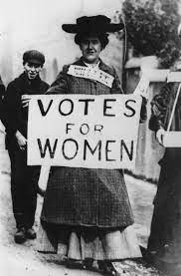
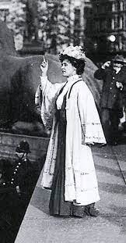
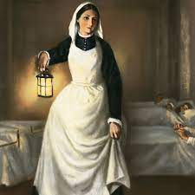
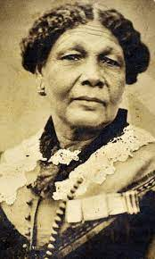
Knowledge Organiser
Year 1
Subject: History Main Learning: Significant or famous people or events
Vocabulary
Emily Pankhurst | Born in 1858 she fought for women to have the right to vote
suffragette | This is the name of the movement that fought for equal rights for women
Florence Nightingale | Born in 1820 she campaigned to make hospitals more hygienic
Mary Seacole | Born in 1802, she also became famous for looking after injured soldiers
Julia Donaldson | A famous author who wrote, amongst other books ‘The Gruffalo’
Marcus Rashford | A footballer who plays for Manchester United and is campaigning to make sure all children have food each day
Key knowledge
Who are and were the famous people from your locality
Know what we mean by the term ‘famous’
Know about famous people form the past who lived locally
Know about the impact of a local famous person on our lives today
Know about a famous person from the UK that has made a difference to people’s lives
Know about someone famous from your area that is still alive today
 | Prior Knowledge –

Slide 13
Long-term overview for HISTORY
YEAR 1
How have our homes changed over time?
Know how we prepared our food at home has changed over time
Examine a range of kitchen artefacts and recognise how they have changed over time
Recognise how technology has changed our home lives over the last century
Select an aspect like the telephone, television, the way we heat our homes and consider how these have changed
Know how we have changed our use of areas outside the house, i.e., gardens
Chronology & Causation | Historical Enquiry | Interpretation & Significance
To appreciate the difference between long ago and very long ago Create a simple timeline to capture recent events Recognise that familiar objects we have today would have been different in the past, i.e., telephone Know what a number of older objects were used for Use words to show the passing of time: old, new, earliest, latest, past, present, future, century, new, newest, oldest, modern, before, after | Respond to simple questions about the past Observe and handle artefacts and ask simple questions about the past Offer an opinion as to why something may have happened in the past and why they know | To identify similarities and differences between different times Begin to identify and recount historic details from the past from sources e.g. pictures/stories To begin to understand that an invention can sometime have a positive impact on an artefact we use everyday, for example, television Consider the differences between ‘long ago’ and ‘now’

Slide 14
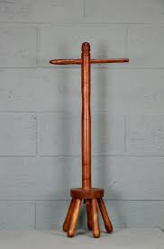
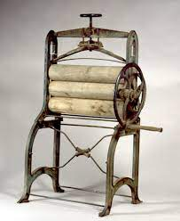
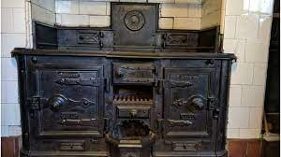
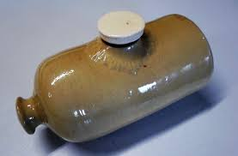
Knowledge Organiser
Year 1
Subject: History Main Learning: Chronology – How homes have changed over time
Key knowledge
Know how we prepared our food at home has changed over time
Know how we prepared our food at home has changed over time
Examine a range of kitchen artefacts and recognise how they have changed over time
Recognise how technology has changed our home lives over the last century
Select an aspect like the telephone, television, the way we heat our homes and consider how these have changed
Know how we have changed our use of areas outside the house, i.e., gardens
Vocabulary
mangle | A mechanical laundry aid consisting of two rollers in a sturdy frame
dolly | Three or four legs on a long handle used for washing clothes in Victorian times and just after
pantry | A place where food was stored – especially before fridges were available in homes
stove | A large heating device used for cooking and sometimes to heat the room
couch | This is what the settee was called
scullery | The place where the cooking took place
 | Prior Knowledge –

Slide 15
Long-term overview for HISTORY
YEAR 2
How did the Victorians influence our life today?
Know who the Victorians were
Know what is meant by the industrial revolution
Know how the industrial revolution changed many towns and cities in Britain
Know that children’s lives today are different to children’s lives in the Victorian era
Know what school was like in the Victorian era
Chronology & Causation | Historical Enquiry | Interpretation & Significance
Recognise that stories they have read help them understand about the differences that exists between the place they live in and places in the past Begin to appreciate the difference between long ago and very long ago Know where the people and events studied fit into a basic timeline Able to point out a few similarities and differences between ways of life at different times Able to order a few events and artefacts from the recent past Use words and phrases such as: old, new, earliest, latest, past, present, future, century, new, newest, old, oldest, modern, before, after to show the passing of time | Look carefully at pictures and objects to find information. Find answers and respond to simple questions about the past. Choose and select evidence and says how it can be used to find out about the past Understand some ways we find out about the past Recognise the importance of basing ideas on evidence Develop the idea of presenting an idea and raising questions about the past | Recount historic details from eye-witness accounts, photos and artefacts To begin to reflect on the significance of what has been learnt from the past To develop an awareness of the past and comment on how they found they found out

Slide 16
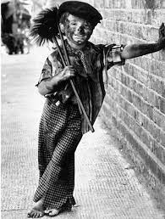
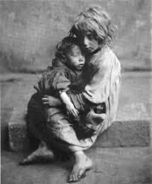
Knowledge Organiser
Year 2
Subject: History Main Learning: A very long time ago - Victorians
Key knowledge
Know how different life was in Victorian Britain
Know who the Victorians were
Know what was meant by the industrial revolution
Know how the industrial revolution changed many towns and cities in Britain
Know that children’s lives today are different to those of children’s lives in the Victorian era
Know what school was like in the Victorian era
Vocabulary
workhouse | The home to many orphaned or sick children. It was also home to poor people without a job
farthing | A coin that was worth a quarter of an old penny. Four farthings made an old penny
gramophone | An old type of record player that played records
gruel | A food consisting of some type of cereal - oat, wheat or rye flour, or rice - boiled in water or milk
Industrial revolution | Rapid development of industry thanks to machinery
chimney sweep | Young children sent up chimneys to clean the soot from the chimney breast
 | Prior Knowledge –

Slide 17
Long-term overview for HISTORY
YEAR 2
What lessons have we learned from the Great Fire of London?
Know why the fire burnt for many days
Know how fire fighting equipment has changed over the years
Know why we know the fire actually happened
Know why different types of fire creates problems even today
Know what people learnt from the fire and how it improved London
Chronology & Causation | Historical Enquiry | Interpretation & Significance
Recognise that stories they have read help them understand about the differences that exists between the place they live in and places in the past Begin to appreciate the difference between long ago and very long ago Know where the people and events studied fit into a basic timeline Able to point out a few similarities and differences between ways of life at different times Able to order a few events and artefacts from the recent past Use words and phrases such as: old, new, earliest, latest, past, present, future, century, new, newest, old, oldest, modern, before, after to show the passing of time | Look carefully at pictures and objects to find information. Find answers and respond to simple questions about the past. Choose and select evidence and says how it can be used to find out about the past Understand some ways we find out about the past Recognise the importance of basing ideas on evidence Develop the idea of presenting an idea and raising questions about the past | Recount historic details from eye-witness accounts, photos and artefacts To begin to reflect on the significance of what has been learnt from the past To develop an awareness of the past and comment on how they found they found out

Slide 18
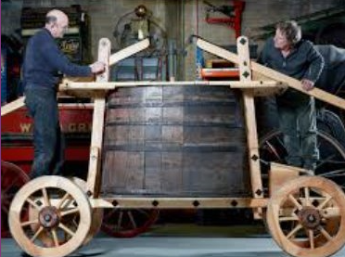
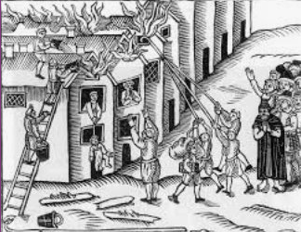
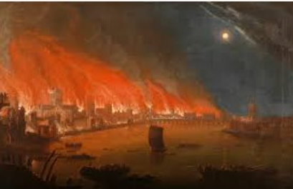
Knowledge Organiser
Year 2
Subject: History Main Learning: A very long time ago – Great Fire of London
Key knowledge
Know what lessons we learnt from the Great Fire of London
Know why the fire burnt for many days
Know how fire fighting equipment has changed over the years
Know why we know the fire actually happened
Know why different types of fire creates problems even today
Know what people learnt from the fire and how it improved London
Vocabulary
Pudding Lane | The fire started here in a bakery
Thomas Farynor | The owner of the bakery
Samuel Pepys | Famous for his diary writing which included the events of the great fire
Leather buckets | These were used to fetch water from the Thames in order to try and put out the fire
plague | A terrible disease that is sometimes known as the Black Death which spread in London just before the fire broke out
Thames | The river that runs through London and where they got the water to try and put out the fire
 | Prior Knowledge –

Slide 19
Long-term overview for HISTORY: Black History
YEAR 2
What we know about the contribution of black people to world history?
Know about Lewis Howard Latimer’s inventions
Know what is meant by being a slave
Know about Mary Prince and her contribution to free slaves
Know what life was like for black people who came to Britain
Know what it means to be black
Chronology & Causation | Historical Enquiry | Interpretation & Significance
Recognise that stories they have read help them understand about the differences that exists between the place they live in and places in the past Describe memories and changes that have happened in their own lives Know where the people and events studied fit into a basic timeline Able to point out a few similarities and differences between ways of life at different times Use words and phrases such as: old, new, earliest, latest, past, present, future, century, new, newest, old, oldest, modern, before, after to show the passing of time | Look carefully at pictures and objects to find information. Find answers and respond to simple questions about the past. Choose and select evidence and say how it can be used to find out about the past Understand some ways we find out about the past Recognise the importance of basing ideas on evidence Develop the idea of presenting an idea and raising questions about the past | Know about people in the past who have contributed to national and international achievements Recount historic details from eye-witness accounts, photos and artefacts To begin to reflect on the significance of what has been learnt from the past To develop an awareness of the past and comment on how they found out

Slide 20
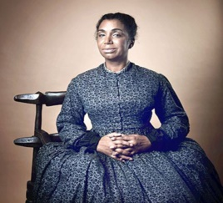
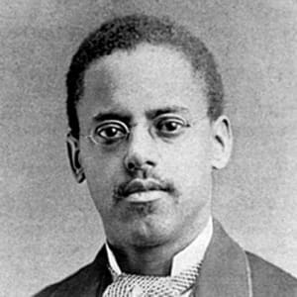
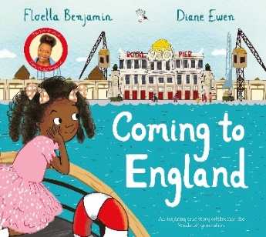
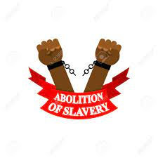
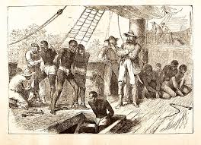
Knowledge Organiser: Black History
Year 2
Subject: History Main Learning: Impact of black people on the world
Key knowledge
Know about the contribution of black people to world history
Know about Lewis Howard Latimer’s inventions
Know what is meant by being a slave
Know about Mary Prince and her contribution to free slaves
Know what life was like for black people who came to Britain
Know what it means to be black
Vocabulary
slavery | People that are kept as prisoners and forced to work for no pay
abolished | To remove something – in this case to remove slavery
campaign | An organised way of stopping something happening
ethnicity | Describes a person’s background in terms of where their family came from
property | Slaves were seen as the property, or belonging to, their masters
equality | To be the same as anyone else and have no prejudice
 | Prior Knowledge –

Slide 21
Long-term overview for HISTORY
YEAR 3
How did Britain change between the beginning of the Stone age and the end of the Iron age?
Know the significance of the invention of the wheel
Know the significance of the discovery of iron ore
Know some of the key differences between the stone, bronze and iron ages
Know about the significance of the creation of Iron Age Forts
Know what is meant by hunter gatherers
Chronology & Causation | Historical Enquiry | Interpretation & Significance
Begin to understand that the past is divided into different named periods of time Able to use dates to explain British, local and world history Start using a timeline that identifies different centuries Use appropriate dates and chronological conventions, e.g., BC, BCE and AD Put artefacts or information in chronological order from a long time ago Understand that significant discoveries or inventions created much change to the lives of people, e.g. the wheel or iron ore | Use a variety of sources to collect information about the past Suggest sources of evidence from a selection to help answer questions and says how it can be used to find out about the past Explain that there are different types of evidence and sources that can be used to help represent the past | Observe and use pictures, photographs and artefacts to find out about the past Start to use stories or accounts to distinguish between fact and fiction Explain that there are different types of evidence and sources that can be used to help represent the past

Slide 22
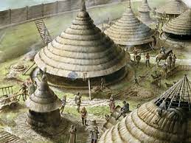
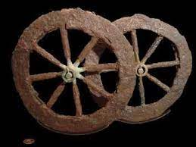
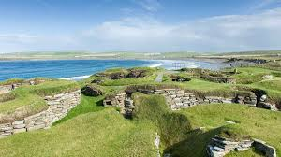
Knowledge Organiser
Year 3
Subject: History Main Learning: Chronology – Beginning of Stone Age to the end of the Iron Age
Vocabulary
hunter-gatherers | Mainly living by hunting, fishing and gathering wild fruit
settlement | A small number of people living together
Iron Age forts | A settlement built on a hill so that it was easier to defend against enemies
Skara Brae | The archaeological site found on the Orkney Islands in Scotland
Stonehenge | A famous Stone Age monument in Wiltshire
archaeologists | People who discover our history by looking at artefacts that have been found
Key knowledge
Know how Britain changed from the stone age to the end of the iron age
Know the significance of the invention of the wheel
Know the significance of the discovery of iron ore
Know some of the key differences between the stone, bronze and iron ages
Know about the significance of the creation of Iron Age Forts
Know what is meant by hunter gatherers
 | Prior Knowledge –

Slide 23
Long-term overview for HISTORY
YEAR 3
Why were the Mayans the envy of the world?
Know what was happening in Britain when the Mayans were most powerful
Know how different the Mayans and the Egyptian pyramids were
Know how the Mayans’ belief in Gods created a culture of sacrifice
Understand how the pok-ta-pok Mayan game could be described as the earliest football match
Understand why the Mayans civilization died out
Chronology & Causation | Historical Enquiry | Interpretation & Significance
Begin to understand that the past is divided into different named periods of time Able to use dates to explain British, local and world history Start using a timeline that identifies different centuries Use appropriate dates and chronological conventions, e.g., BC, BCE and AD Put artefacts or information in chronological order from a long time ago | Use a variety of sources to collect information about the past Suggest sources of evidence from a selection to help answer questions and says how it can be used to find out about the past Explain that there are different types of evidence and sources that can be used to help represent the past | Start to compare two versions of a past event Observe and use pictures, photographs and artefacts to find out about the past Start to use stories or accounts to distinguish between fact and fiction Explain that there are different types of evidence and sources that can be used to help represent the past

Slide 24
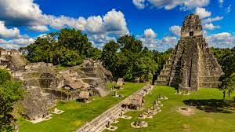
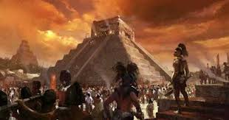
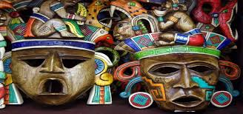
Knowledge Organiser
Year 3
Subject: History Main Learning: Civilizations _ Mayans
Key knowledge
Know about the Mayans and what they gave society
Know what was happening in Britain when the Mayans were most powerful
Know how different the Mayans and the Egyptian pyramids were
Know how the Mayans’ belief in Gods created a culture of sacrifice
Understand how the pok-ta-pok Mayan game could be described as the earliest football match
Understand why the Mayans civilization died out
Vocabulary
Chichen Itza | The Mayans most well-known pyramid
Itzamna | The main god of the Maya, Itzamna was the god of fire who created the Earth
codices | Books, made of soft bark and folded like a fan, created by the Mayans
ahau or ahaw | The main king or lord of a Maya city-state
batab | A lesser lord, usually ruling over a small town
Kukulcan | The serpent god of the Maya. One of the primary gods, especially to the Itza peoples of Chichen Itza
 | Prior Knowledge –

Slide 25
Long-term overview for HISTORY
YEAR 3
Why does Bury exists in the first place?
Know the impact of the industrial revolution on Bury
Know how evidence of the industrial revolution can be seen in Bury today
Know about Bury market and its importance in promoting Bury’s name
Know how Bury had a prisoner of war camp during WW2
Know about steam trains and how these were very important form of travel in the past
Chronology & Causation | Historical Enquiry | Interpretation & Significance
Able to use dates to explain British and local history Start using a timeline that identifies different centuries Put artefacts or information in chronological order from a long time ago | Use a variety of sources to collect information about the past Suggest sources of evidence from a selection to help answer questions and says how it can be used to find out about the past Explain that there are different types of evidence and sources that can be used to help represent the past | Observe and use pictures, photographs and artefacts to find out about the past Start to use stories or accounts to distinguish between fact and fiction Explain that there are different types of evidence and sources that can be used to help represent the past

Slide 26
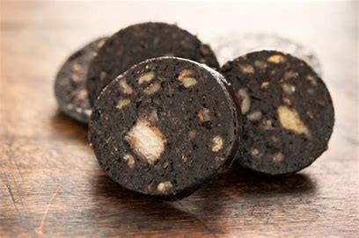
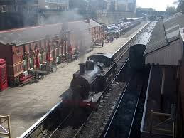
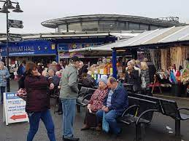
Knowledge Organiser
Year 3
Subject: History Main Learning: Local History - Bury
Vocabulary
Wharth mills | This was a prisoner of war camp on the outskirts of Bury
black pudding | A black sausage containing pork, dried pig's blood, and suet which is strongly associated with Bury
Bury | The name originates from an old English word meaning fort. Castle or stronghold
market | Usually an outdoor area where people sell a variety of goods but not from a shop
industrial revolution | Began in around 1760 and lasted for about 100 years. It is when machinery was introduced to mass produce goods
steam train | These were locomotives powered by coal and had chimneys which puffed out steam.
Key knowledge
Know why Bury exists in the first place
Know the impact of the industrial revolution on Bury
Know how evidence of the industrial revolution can be seen in Bury today
Know about Bury market and its importance in promoting Bury’s name
Know how Bury had a prisoner of war camp during WW2
Know about steam trains and how these were very important form of travel in the past
 | Prior Knowledge –

Slide 27
Long-term overview for HISTORY
YEAR 4
How did Britain change between the end of the Iron age and the end of the Roman occupation?
Know why the Romans came to Britain in the first place
Know how the Romans changed the landscape in Britain
Know why there was some resistance to the Roman occupation
Consider what was the most important change the Romans brought to Britain
Know why the Romans left Britain
Chronology & Causation | Historical Enquiry | Interpretation & Significance
To be able to place events, people and changes of British, local and world history on a timeline To accurately set out different events onto a timeline To appreciate that some major events in the past caused a major change to the British landscape, e.g., Roman occupation Sequence several events, artefacts or historical figures on a timeline using dates, including those that are sometimes further apart Know how to use the timeline in relation to the unit being studied. Use words and phrases: century, decade | Know the difference between primary and secondary sources of evidence Use a range of sources to collect information about the past Construct informed responses about one aspect of life | Look at more than two versions of the same event or story in history and identifies differences Investigate different accounts of historical events and explain some of the reasons why the accounts may be different To begin to talk about the impact of a past action on our lives today To be able to talk about similarities and differences between different times in the past according to the periods of history studied

Slide 28
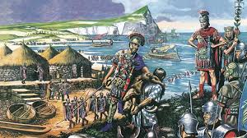
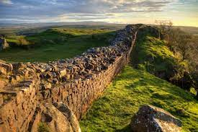
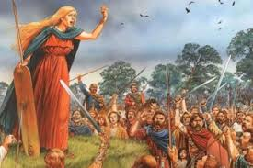
Knowledge Organiser
Year 4
Subject: History Main Learning: Chronology – End of Iron Age to end of Roman occupation
Key knowledge
Know how Britain changed between the end of the Iron Age and the end of the Roman occupation
Know why the Romans came to Britain in the first place
Know how the Romans changed the landscape in Britain
Know why there was some resistance to the Roman occupation
Consider what was the most important change the Romans brought to Britain
Know why the Romans left Britain
Vocabulary
centurion | A commander of a group of 100 Roman soldiers
Londinium | This was the Roman name for London
Romanisation | When the countries that the Romans conquered became very much like Rome
invade | Enter a place or land with the intention of occupying it
aqueduct | A large system, like a bridge, for carrying water from one place to another
senate | Similar to the Roman version of our parliament
 | Prior Knowledge –

Slide 29
Long-term overview for HISTORY
YEAR 4
Why was Ancient Egypt’s civilization ahead of its time?
Know what was happening in Britain when the Ancient Egyptians were at their most powerful
Understand how archaeologists have helped us know what happened in Ancient Egypt, Ancient Sumer, the Indus Valley and the Shan Dynasty many years ago
Know how the Ancient Egyptians were influenced by the Gods
Know how the powerful Egyptians create a culture of slavery
Chronology & Causation | Historical Enquiry | Interpretation & Significance
To be able to place events, people and changes of British, local and world history on a timeline To accurately set out different events onto a timeline Sequence several events, artefacts or historical figures on a timeline using dates, including those that are sometimes further apart Know how to use the timeline in relation to the unit being studied. Use words and phrases: century, decade Know how some historical events/periods occurred concurrently in different locations, e.g. Indus Valley and Ancient Egypt. | Know the difference between primary and secondary sources of evidence Use a range of sources to collect information about the past Construct informed responses about one aspect of life | Look at more than two versions of the same event or story in history and identifies differences Investigate different accounts of historical events and explain some of the reasons why the accounts may be different To begin to talk about the impact of a past action on our lives today To be able to talk about similarities and differences between different times in the past according to the periods of history studied

Slide 30
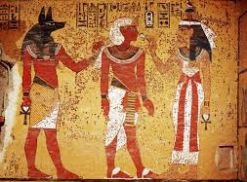
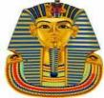

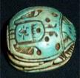
Knowledge Organiser
Year 4
Subject: History Main Learning: Civilizations – Ancient Egypt
Key knowledge
Know that there were several advanced civilizations on Earth around 3000 years ago
Know what was happening in Britain when the Ancient Egyptians were at their most powerful
Understand how archaeologists have helped us know what happened in Ancient Egypt, Ancient Sumer, the Indus Valley and the Shan Dynasty many years ago
Know how the Ancient Egyptians were influenced by the Gods
Know how the powerful Egyptians create a culture of slavery
Vocabulary
pharaohs | Originally meant ‘great house’, but came to mean the person who resided in it
pyramid | A geometrical term that refers to part of the burial complexes for Egyptian pharaohs
hieroglyphs | Refers to the fact that it is carving for sacred things, but hieroglyphs were also written on papyrus
vizier | The most powerful position after the king. A vizier was the equivalent of a modern day prime minister.
sarcophagus | Sarcophagus is a Greek word meaning flesh-eating and refers to the mummy case
papyrus | An Egyptian plant whose reeds are slit and placed in layers in order to form paper
 | Prior Knowledge –

Slide 31
Long-term overview for HISTORY: Black History
YEAR 4
What did it mean to be a slave?
Know where slaves came from
Know where slaves were taken to
Know why black people were enslaved
Know about how slaves were treated
Know about the people that tried to stop slavery
Chronology & Causation | Historical Enquiry | Interpretation & Significance
To be able to place events, people and changes of British, local and world history on a timeline To accurately set out different events onto a timeline To appreciate that some major events in the past caused a major change to the British landscape, e.g., abolishment of slavery Sequence several events, artefacts or historical figures on a timeline using dates, including those that are sometimes further apart Know how to use the timeline in relation to the unit being studied. Use words and phrases: century, decade | Know the difference between primary and secondary sources of evidence Use a range of sources to collect information about the past Construct informed responses about one aspect of life | Look at more than two versions of the same event or story in history and identifies differences Investigate different accounts of historical events and explain some of the reasons why the accounts may be different To begin to talk about the impact of a past action on our lives today To be able to talk about similarities and differences between different times in the past according to the periods of history studied

Slide 32
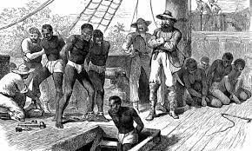
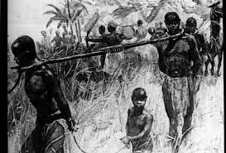
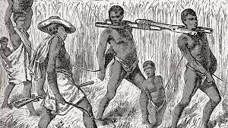
Knowledge Organiser: Black History
Year 4
Subject: History Main Learning: Slavery
Vocabulary
race | A group of people identified as distinct from other groups because of physical or genetic traits shared by the group
slavery | A system of people working hard for no money and being ‘owned’ by a wealthy person
freedom | The right to act, speak, or think as one wants
abolishment | To put an end to (slavery)
inherently inferior | A belief that black people were less important than white people
Atlantic slave trade | The transportation by slave traders of various enslaved African people, mainly to the America
Key knowledge
Know what it meant to be a slave
Know where slaves came from
Know where slaves were taken to
Know why black people were enslaved
Know about how slaves were treated
Know about the people that tried to stop slavery
 | Prior Knowledge –

Slide 33
Long-term overview for HISTORY
YEAR 5
What did the Ancient Greeks bring to the world?
Know why the Ancient Greeks were more advanced than Ancient Britons
Know what the Ancient Greeks introduced that we benefit from today
Know how the Ancient Greeks were influenced by their Gods
Know how important philosophy and democracy was in helping the Greeks to be remembered today
Know what the main characteristics of the Spartans and the Athenians were
Chronology & Causation | Historical Enquiry | Interpretation & Significance
To show a chronologically secure knowledge and understanding of local, national and global history To be able to tell the story of events within and across the time periods studied To describe connections. contrasts and trends over short and longer time periods Order an increasing number of significant events, movements and dates on a timeline using dates accurately; Accurately use dates and terms to describe historical events; | Recognise when they are using primary and secondary sources of information to investigate the past Select relevant sections of information to address historically valid questions and construct detailed, informed responses Use a wide range of different evidence to collect evidence about the past To be able to devise questions about change, cause and consequences, similarity, difference and significant people or events in a wider context | Find and analyse a wide range of evidence about the past Use a range of evidence to offer some clear reasons for different interpretations of events, linking this to factual understanding about the past Consider different ways of checking the accuracy of interpretations of the past; Realise that there is often not a single answer to historical questions To see the relationship between different periods and the legacy or impacts for people today

Slide 34
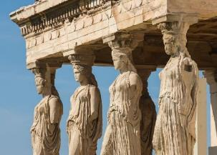
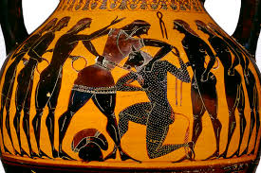
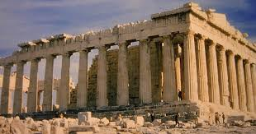
Knowledge Organiser
Year 3
Subject: History Main Learning: Civilizations - Ancient Greeks
Key knowledge
Know what the Ancient Greeks gave the world
Know why the Ancient Greeks were more advanced than Ancient Britons
Know what the Ancient Greeks introduced that we benefit from today
Know how the Ancient Greeks were influenced by their Gods
Know how important philosophy and democracy was in helping the Greeks to be remembered today
Know what the main characteristics of the Spartans and the Athenians were
Vocabulary
philosophy | Is a way of thinking about the world, the universe, and society
Athenians | Residents of the ancient city-state of Greece, Athens, in around the 5th century BC
Spartans | Believed that strict discipline and a tough upbringing was the secret to making the best soldiers
democracy | Allowing citizens to make their own decisions for their personal lives
Zeus | The supreme God of the Olympians
Olympics | The ancient Olympic Games were originally a festival, or celebration of Zeus
 | Prior Knowledge –

Slide 35
Long-term overview for HISTORY
YEAR 5
Why is the city of Manchester so great?
Know about Manchester’s Roman origins
Know the impact that the industrial revolution had on Manchester
Know about the significance of the Peterloo massacre
Know how sport became associated with Manchester
Know about the famous Manchester people that influenced society
Chronology & Causation | Historical Enquiry | Interpretation & Significance
To show a chronologically secure knowledge and understanding of local, national and global history To be able to tell the story of events within and across the time periods studied To describe connections. contrasts and trends over short and longer time periods Order an increasing number of significant events, movements and dates on a timeline using dates accurately; Accurately use dates and terms to describe historical events; Know and describe in some detail the main changes to an aspect of history for Manchester | Recognise when they are using primary and secondary sources of information to investigate the past Select relevant sections of information to address historically valid questions and construct detailed, informed responses Use a wide range of different evidence to collect evidence about the past To be able to devise questions about change, cause and consequences, similarity, difference and significant people or events in a wider context | Find and analyse a wide range of evidence about the past Use a range of evidence to offer some clear reasons for different interpretations of events, linking this to factual understanding about the past Consider different ways of checking the accuracy of interpretations of the past; Realise that there is often not a single answer to historical questions To be able to discuss trends over time To see the relationship between different periods and the legacy or impacts for people today

Slide 36
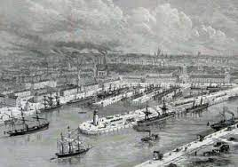
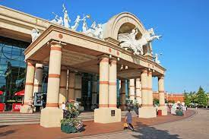
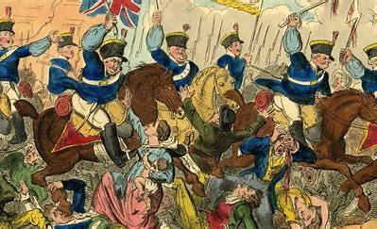
Knowledge Organiser
Year 5
Subject: History Main Learning:
Significance – History of Manchester
Vocabulary
Peterloo massacre | Refers to the charge made by the parliament’s officers against the demonstrating working class
Trafford Centre | A huge shopping centre built in the 1990’s just outside Manchester
Mamucium | The original name for Manchester in Roman times
cottonopolis | The name used to depict Manchester’s wealth at the height of the industrial revolution
Industrial revolution | The name given to the period of British history when industry took off (1800s to 1950)
Henry Hunt | A radical speaker who spoke up for the working class people
Key knowledge
Know about Manchester’s history
Know about Manchester’s Roman origins
Know the impact that the industrial revolution had on Manchester
Know about the significance of the Peterloo massacre
Know how sport became associated with Manchester
Know about the famous Manchester people that influenced society
 | Prior Knowledge –

Slide 37
Long-term overview for HISTORY
YEAR 5
How did Britain change between the end of the Roman occupation and 1066?
Know why the Romans left Britain
Know who the Anglo-Saxons were and how they divided Britain up
Know who the Vikings were and how they battled with the Anglo-Saxons
Know how many of the words we use today originate from the Anglo-Saxons or the Vikings
Know how the Vikings and Anglo-Saxons improved Britain
Chronology & Causation | Historical Enquiry | Interpretation & Significance
To have a secure understanding of a British timeline that extends from the Stone Age to the present day To show a chronologically secure knowledge and understanding of local, national and global history To be able to tell the story of events within and across the time periods studied To describe connections. contrasts and trends over short and longer time periods Order an increasing number of significant events, movements and dates on a timeline using dates accurately; Accurately use dates and terms to describe historical events; Know and describe in some detail the main changes to an aspect in a period of history being studied | Recognise when they are using primary and secondary sources of information to investigate the past Select relevant sections of information to address historically valid questions and construct detailed, informed responses Use a wide range of different evidence to collect evidence about the past To be able to devise questions about change, cause and consequences, similarity, difference and significant people or events in a wider context | Find and analyse a wide range of evidence about the past Use a range of evidence to offer some clear reasons for different interpretations of events, linking this to factual understanding about the past Realise that there is often not a single answer to historical questions To see the relationship between different periods and the legacy or impacts for people today

Slide 38
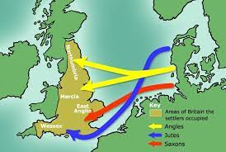
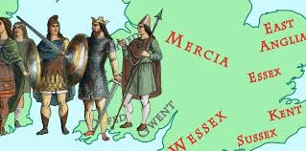
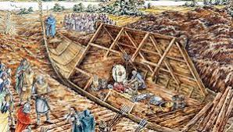
Knowledge Organiser
Year 5
Subject: History Main Learning: Chronology – end of Roman occupation to 1066
Key knowledge
Know how Britain changed between the end of the Roman occupation and 1066
Know why the Romans left Britain
Know who the Anglo-Saxons were and how they divided Britain up
Know who the Vikings were and how they battled with the Anglo-Saxons
Know how many of the words we use today originate from the Anglo-Saxons or the Vikings
Know how the Vikings and Anglo-Saxons improved Britain
Vocabulary
Anglo-Saxon kingdoms | The Anglo-Saxons formed many regions each with one ruler, known as kingdoms
Shire reeve | The peace officer of a shire, later known as ‘sheriff’.
churl | A lower-class Anglo-Saxon but better than a slave
longship | The narrow boat used by Vikings to raid along coasts
longhouse | A large hall-like building where many Viking families would live together
Jorvik | The Viking name for the city of York. York now has a famous Viking museum called Jorvik
 | Prior Knowledge –

Slide 39
Long-term overview for HISTORY
YEAR 6
What impact did WW1 and WW2 have on ordinary people in your local area?
Know how lives of ordinary people started to change after WW1
Make use of evidence to find out why WW2 happened
Know the impact of Chamberlain’s speech on the country
Make use of local evidence to find out about the impact of the wars on local people’s lives
Know about the issues people faced after WW2 ended
Chronology & Causation | Historical Enquiry | Interpretation & Significance
To demonstrate a coherent chronological narrative, knowledge and understanding of Britain’s past and the wider world To identify specific changes within and across different periods over a long period of history Use timelines to place events, periods and cultural movements from around the world. Use timelines to demonstrate changes and developments in culture, technology, religion and society. Describe main changes in a period in history using words such as: social, religious, political, technological and cultural. Name date of any significant event studied from past and place it correctly on a timeline | Use a wide range of different evidence to collect evidence about the past, such as pictures, documents, printed sources, posters, online material, pictures, photographs, artefacts, historic statues, figures, sculptures, historic sites Investigate own lines of enquiry by posing historically valid questions to answer To understand the complexity of people’s lives in the past and how some societies are different due to changes and challenges at that time | Find and analyse a wide range of evidence about the past Use a range of evidence to offer some clear reasons for different interpretations of events, linking this to factual understanding about the past Consider different ways of checking the accuracy of interpretations of the past Start to know the difference between primary and secondary evidence and the impact of this on reliability Show an awareness of the concept of propaganda Know that people in the past represent events or ideas in a way that may be to persuade others Begin to evaluate the usefulness of different sources Form own opinions about historical events from a range of sources

Slide 40
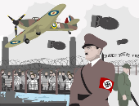
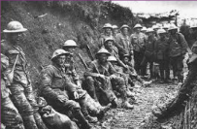

Knowledge Organiser
Year 6
Subject: History Main Learning: Significance – Impact of world wars
Key knowledge
Impact of World wars on ordinary people in the locality
Know how lives of ordinary people started to change after WW1
Make use of evidence to find out why WW2 happened
Know the impact of Chamberlain’s speech on the country
Make use of local evidence to find out about the impact of the wars on local people’s lives
Know about the issues people faced after WW2 ended
Vocabulary
axis | Countries which fought on the German side including Italy, Germany and Japan
Allies | Countries which fought on the British side during WW22 (including: USA, Great Britain, France and Russia
propaganda | Controlling news media (such as radio) to depict the war effort
no man’s land | The area between the two sides during battle.
Armistice Day | The day the agreement was signed between the Allies and Germany to end the war on 11th November
conscription | A rule that said ALL healthy men aged 18 – 41 had to fight
 | Prior Knowledge –

Slide 41
Long-term overview for HISTORY
YEAR 6
Why should gunpowder, treason and plot never been forgotten?
Know about the Gunpowder plot
Know how Henry V111 changed the way we worship
Know why Elizabeth 1’s reign was a time of exploration and discovery
Know who the roundheads and the cavaliers were
Know why the Great Fire may have been one of the best things that happened to London
Chronology & Causation | Historical Enquiry | Interpretation & Significance
To demonstrate a coherent chronological narrative, knowledge and understanding of Britain’s past and the wider world To identify specific changes within and across different periods over a long period of history Use timelines to place events, periods and cultural movements from around the world. Use timelines to demonstrate changes and developments in culture, technology, religion and society. Use these key periods as reference points: BC, AD Romans, Anglo-Saxons, Tudors, Stuarts, Georgians, Victorians and Today. Describe main changes in a period in history using words such as: social, religious, political, technological and cultural. | Recognise when they are using primary and secondary sources of information to investigate the past Select relevant sections of information to address historically valid questions and construct detailed, informed responses Use a wide range of different evidence to collect evidence about the past To be able to devise questions about change, cause and consequences, similarity, difference and significant people or events in a wider context | Use a range of evidence to offer some clear reasons for different interpretations of events, linking this to factual understanding about the past Consider different ways of checking the accuracy of interpretations of the past Start to know the difference between primary and secondary evidence and the impact of this on reliability Show an awareness of the concept of propaganda Know that people in the past represent events or ideas in a way that may be to persuade others

Slide 42





Knowledge Organiser
Year 6
Subject: History Main Learning:
Significance – Gunpowder plot, treason and creating the British Empire
Key knowledge
Know about treason, plots and the civil war
Know about the Gunpowder plot
Know how Henry V111 changed the way we worship
Know why Elizabeth 1’s reign was a time of exploration and discovery
Know who the roundheads and the cavaliers were
Know why the Great Fire may have been one of the best things that happened to London
Vocabulary
cavaliers | The name given to the king’s followers
roundheads | The name given to the Parliamentarians
treason | When someone acts against his or her country
protestants | A Christian not belonging to the Roman Catholic faith
Cromwell | The leader of the Parliamentarians
Robert Catesby | Leader of the group of Catholics who planed the Gunpowder plot
 | Prior Knowledge –

Slide 43
Long-term overview for HISTORY
YEAR 6
What was the impact of immigration on Britain over the past 70 years?
Know why many people found Britain an attractive place to come to live
Know about the prejudice that many immigrants met when they arrived in Britain
Know what is meant by the Windrush generation
Know why there are large Asian communities in the North West of England
Know about the impact many individuals from immigrant families have on our lives today
Chronology & Causation | Historical Enquiry | Interpretation & Significance
To demonstrate a coherent chronological narrative, knowledge and understanding of Britain’s past and the wider world Use timelines to place events, periods and cultural movements from around the world. Use timelines to demonstrate changes and developments in culture, technology, religion and society. Describe main changes in a period in history using words such as: social, religious, political, technological and cultural. Name date of any significant event studied from past and place it correctly on a timeline | Use a wide range of different evidence to collect evidence about the past, such as pictures, documents, printed sources, posters, online material, pictures, photographs, artefacts, historic statues, figures, sculptures, historic sites Investigate own lines of enquiry by posing historically valid questions to answer To understand the complexity of people’s lives in the past and how some societies are different due to changes and challenges at that time | Use a range of evidence to offer some clear reasons for different interpretations of events, linking this to factual understanding about the past Consider different ways of checking the accuracy of interpretations of the past Start to know the difference between primary and secondary evidence and the impact of this on reliability Show an awareness of the concept of propaganda Know that people in the past represent events or ideas in a way that may be to persuade others Form own opinions about historical events from a range of sources

Slide 44



Knowledge Organiser
Year 6
Subject: History Main Learning: Significance – Impact of immigration over past 70 years
Key knowledge
Know about the impact of immigration on Britain over the past 70 years
Know why many people found Britain an attractive place to come to live
Know about the prejudice that many immigrants met when they arrived in Britain
Know what is meant by the Windrush generation
Know why there are large Asian communities in the North West of England
Know about the impact many individuals from immigrant families have on our lives today
Vocabulary
immigration | coming to live permanently in a foreign country
prejudice | preconceived opinion that is not based on reason or actual experience
Caribbean | the region consisting of the Caribbean Sea, its islands (including the West Indies), and the surrounding coasts – where most on the Windrush travelled from
opposition | people who were against the immigration policy
Windrush generation | people arriving in the UK between 1948 and 1971 from Caribbean countries – many travelled on MV Empire Windrush
Asian community | Large numbers of people living in close proximity in different parts of the country having originated from Pakistan, India and Bangladesh
 | Prior Knowledge –

