Slide 1

Rationale
At All Saints’ C.E. Primary School we believe that all children should have the opportunity to experience fundamental childhood experiences.
These opportunities form part of both the explicit and hidden curriculum at All Saints and are planned for throughout the school year whenever possible, both through lessons, WOW experiences and enrichment activities.

Slide 2
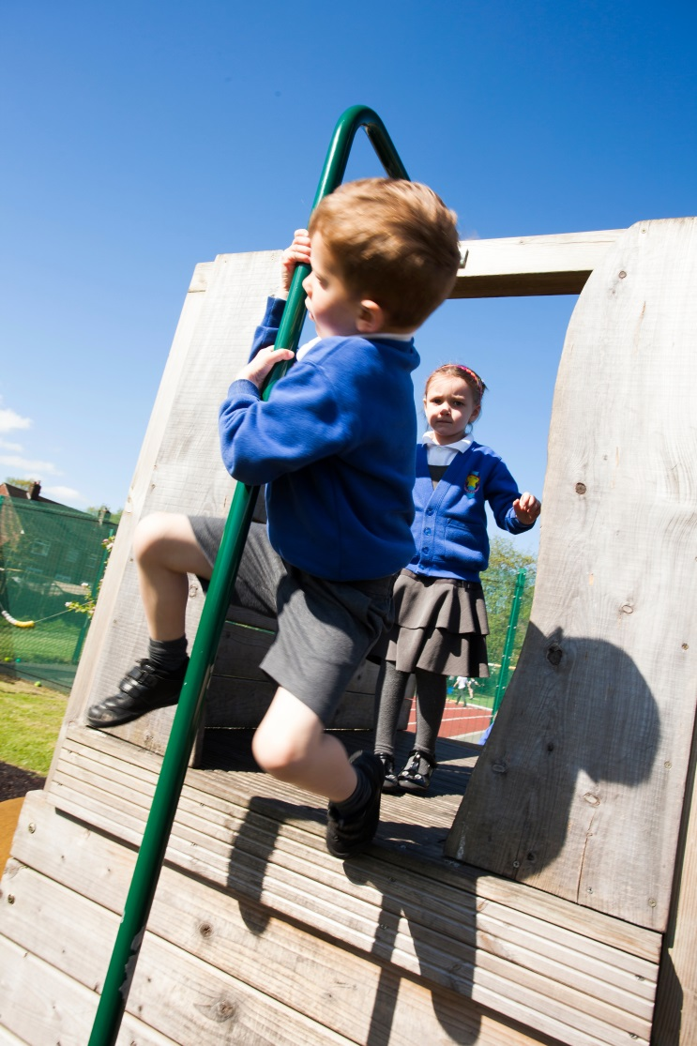
During your time at All Saints you will have the opportunity to……..
Be a Hero by
taking a risk – do things outside your comfort zone
trying new challenges, taking action and putting others before yourself
performing random acts of kindness
promoting the good things in life like charity, kindness, gratitude and love
learning from your own heroes

Slide 3


During your time at All Saints you will have the opportunity to……..
Be a Responsible Citizen who is confident and can make decisions by
being prepared, ready to learn and behaving appropriately
listening and being involved
taking responsibility for your words and actions
treating people with respect
managing your emotions
learning from your mistakes
learning to solve problems
knowing when to ask for help
following the Golden Rule

Slide 4
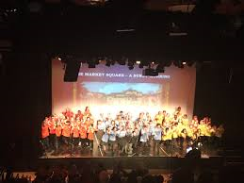
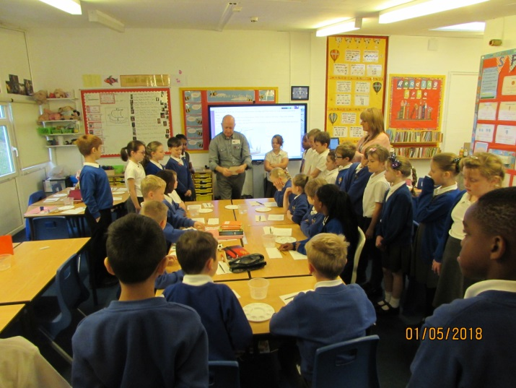
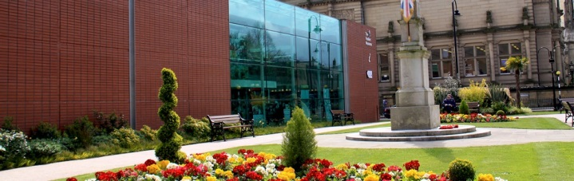
During your time at All Saints you will have the opportunity to……..
Be a Culture Seeker by
visiting the theatre, museum, art gallery, religious buildings
reading a wide range of books from different genres
writing poetry, short stories, books and plays
watching films
listening and enjoying music, also from other countries and in other languages
learning to play a musical instrument
learning a new language
learning from a professional artist and creating your own work of art

Slide 5
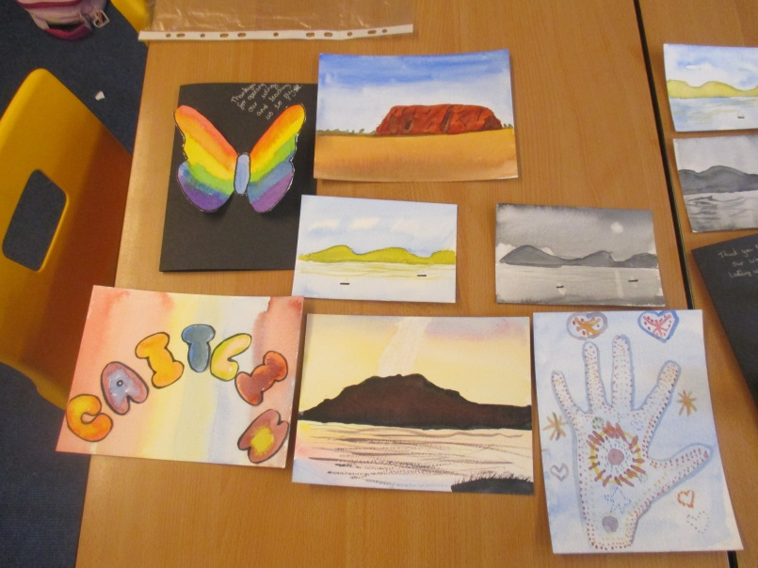
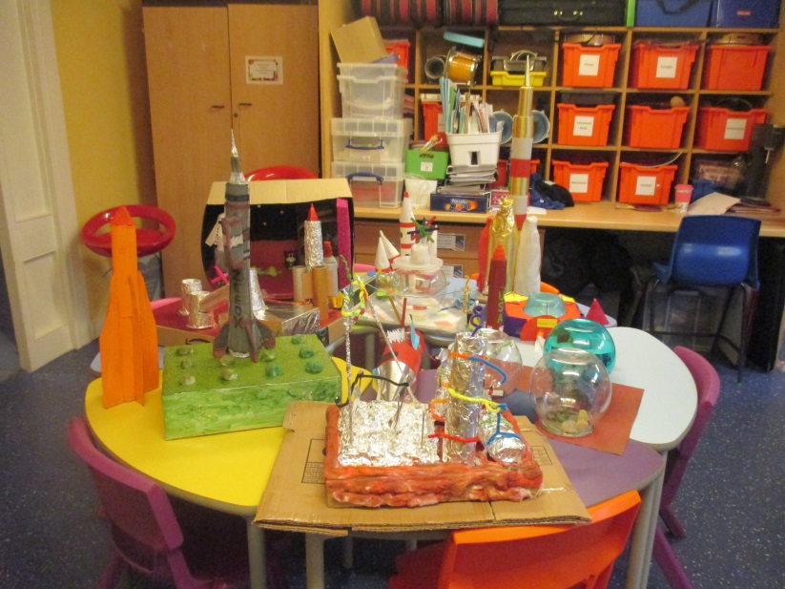
During your time at All Saints you will have the opportunity to……..
Be a Creator by
reading lots of books
being an author and/or poet
taking part in activities such as cooking/woodwork/cross stitch
developing your expertise and picking up a new skill
inspiring yourself by experiencing the creative work of others
being open to new experiences
using your imagination and “thinking outside the box”

Slide 6
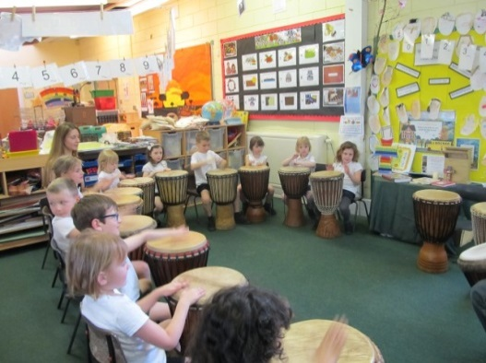
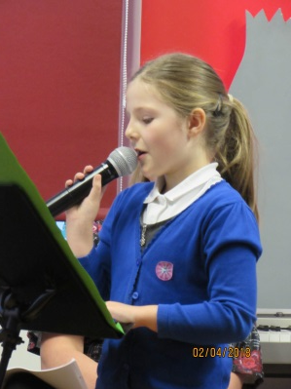
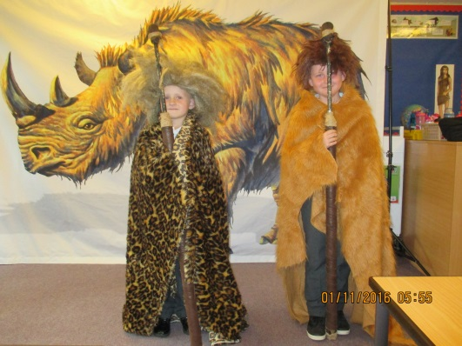
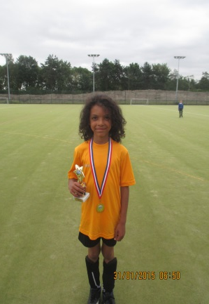
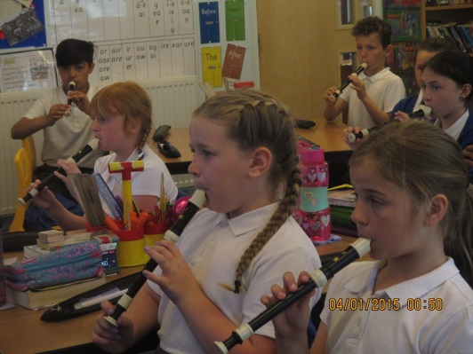
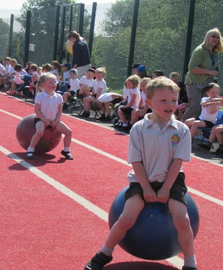
During your time at All Saints you will have the opportunity to……..
Be a Performer by
taking part in a class assembly
being part of a production and/or a musical show
having great stage presence and be able to demonstrate confidence and positivity
showing your audience that you enjoy performing; this will make them enjoy watching you
playing your musical instrument
being part of a sporting event
watching other people’s performance to give you ideas and confidence

Slide 7
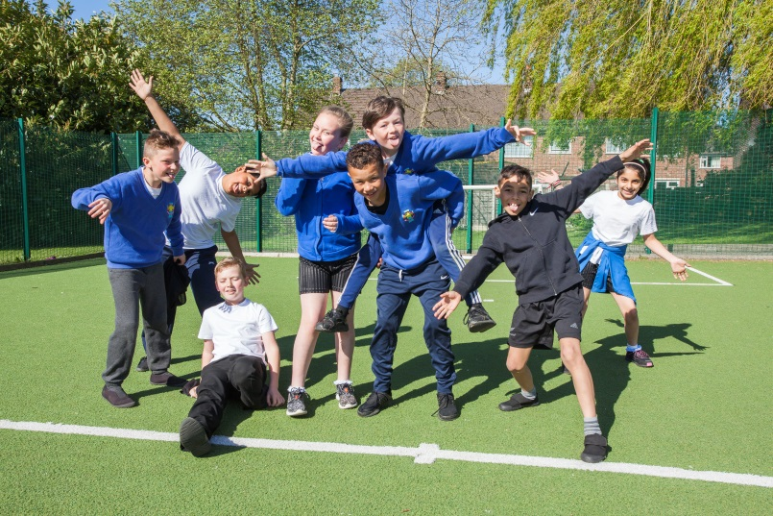
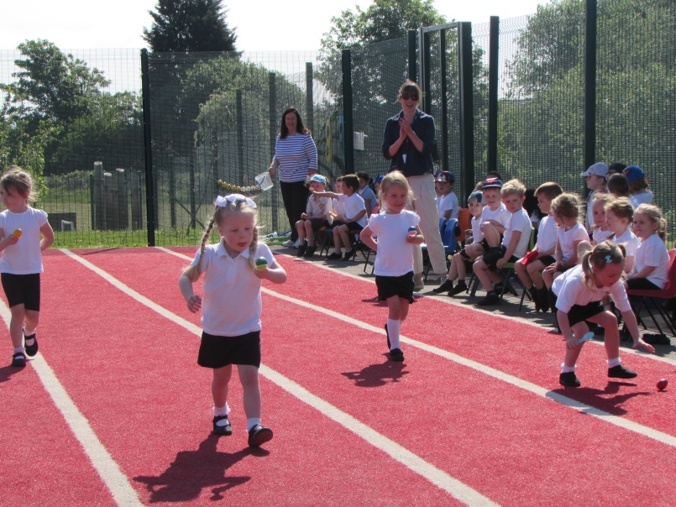
During your time at All Saints you will have the opportunity to……..
Be a Team Player by
listening and communicating clearly with everyone
being reliable and helpful as a member of your team
being given the opportunity to participate in class/group meetings and discussions or team activities
respecting everyone’s opinion and trying to see other people’s points of view
helping to deal with problems and difficult situations, supporting one another
being able to compromise and be flexible
taking responsibility and being willing to admit you could have done something differently
being part of a school club or team
representing your school

Slide 8
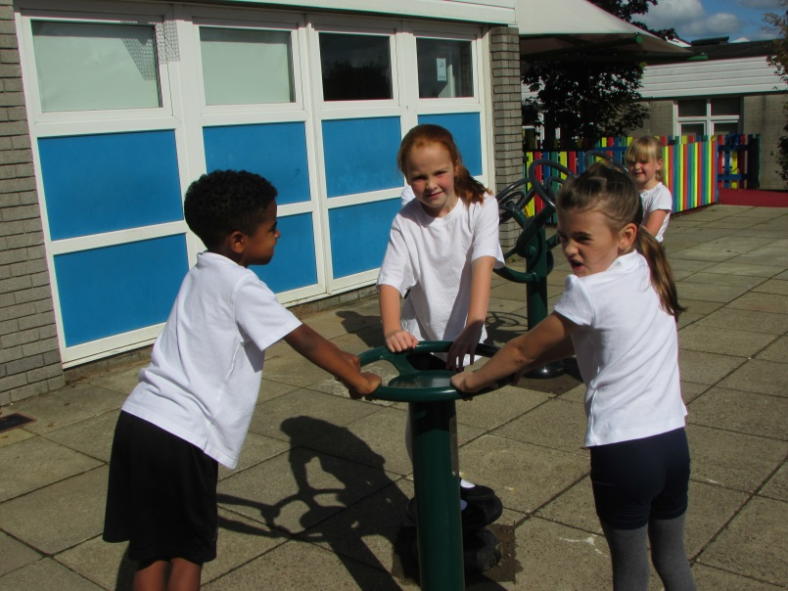

During your time at All Saints you will have the opportunity to……..
Be a Health Expert by
choosing healthy foods
getting some regular exercise
getting a good night’s sleep
avoiding unhealthy habits
remembering good hygiene
experiencing and participating in PSHE lessons and becoming equipped with an awareness of good mental health and wellbeing
learning about how your body works and listening to your body

Slide 9
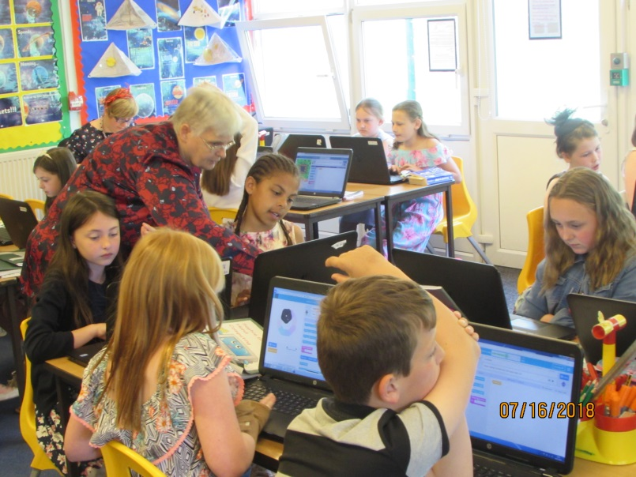
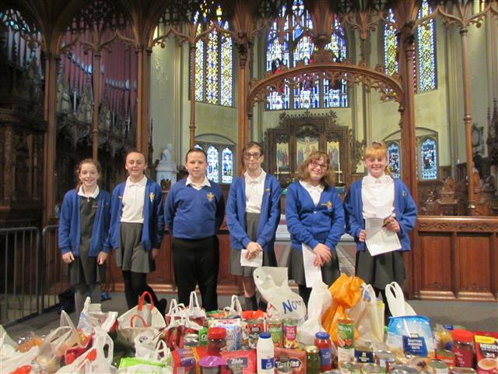
During your time at All Saints you will have the opportunity to……..
Be Aware by
understanding and responding to current events
being a reporter
celebrating important occasions
celebrating religious festivals
being observant of your surroundings and senses
listening to others
taking responsibility for your behaviour, thoughts and feelings
being aware of how to show safe, online behaviours
knowing where it is appropriate and safe to use digital devices

Slide 10
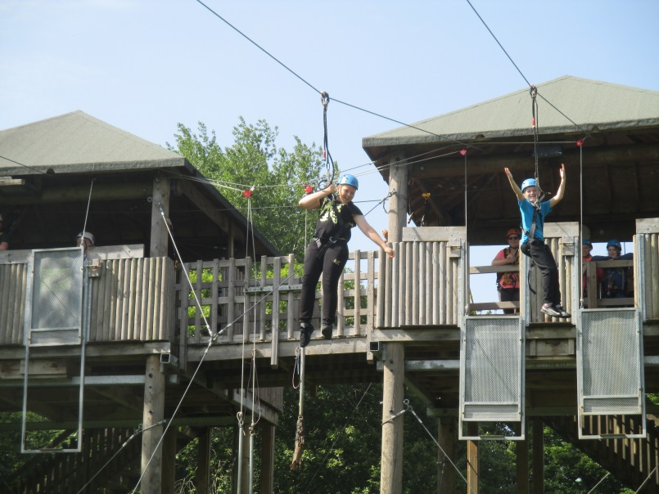
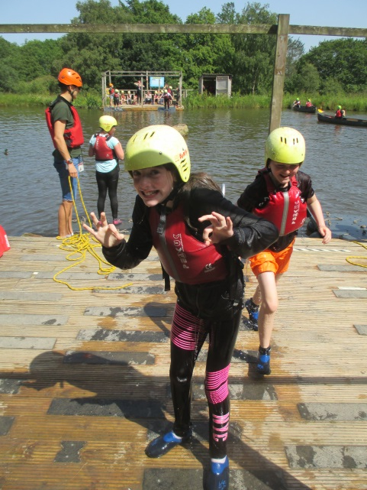
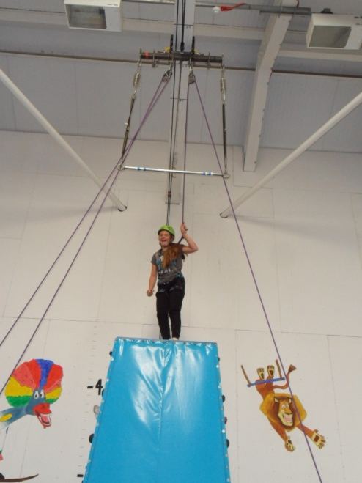
During your time at All Saints you will have the opportunity to……..
Be an Adventurer by
investigating outside
visiting places near and far
learning survival skills
shaking up your life and trying new things
exploring your interests and finding others who share your interests
taking time to have some fun and explore
creating a new habit, learning from people you admire
being curious

Slide 11
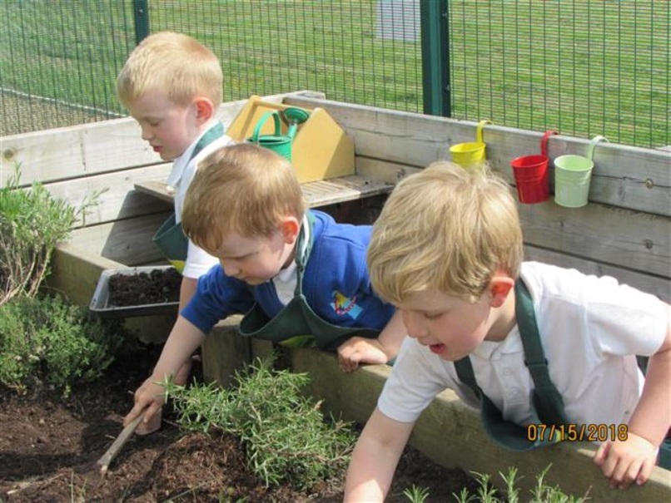
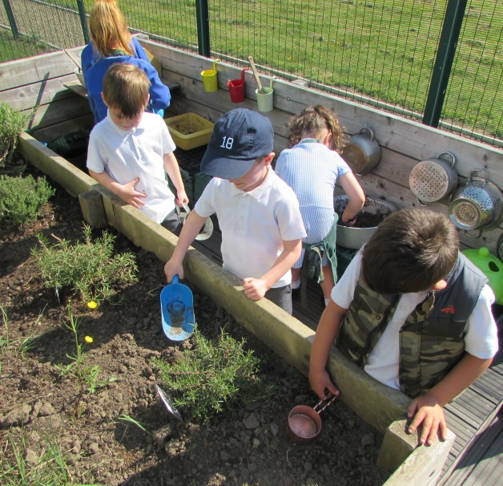
During your time at All Saints you will have the opportunity to……..
Be an Eco Warrior by
being nature-smart by gardening and weather watching
spending time with nature and broadening your views
learning in and about different environments
learning about animals and their habitats
turning off lights that you are not using
using re-usable water bottles
upcycling items – don’t throw something useful away, use it again or find a new way to use it.
recycling
remembering that everything is beautiful in some way

Slide 12
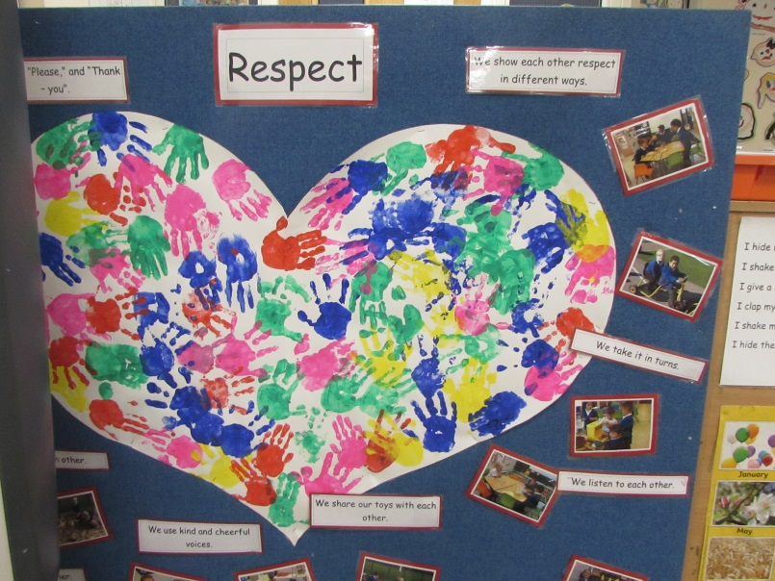
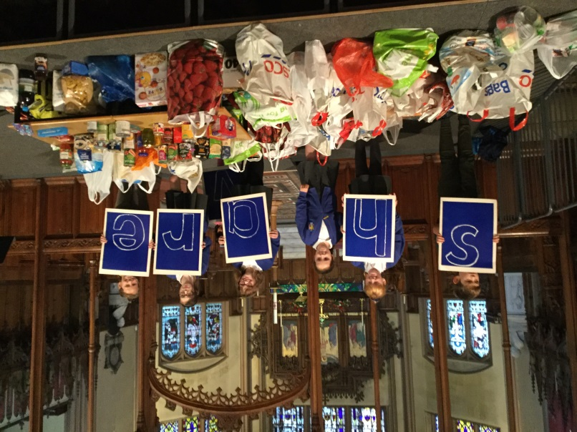
During your time at All Saints you will have the opportunity to……..
Be a Neighbour by
being respectful and considerate
caring for and supporting our school, church and local community
being polite and approachable
donating and raising funds for charity
loving your neighbour as yourself
help keep your neighbourhood and school litter free

Slide 13
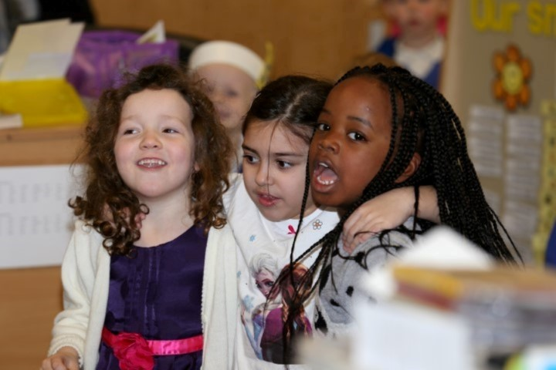

During your time at All Saints you will have the opportunity to……..
Be an Inspirational Child by
trusting yourself and following what you believe in
having a charitable and generous nature
being a great friend
meeting different people who inspire you
not letting what you can’t do stop you from doing what you can do
doing what you can, with what you have, where you are
making each day your masterpiece
realising that winning doesn’t always mean being first
winning means that you are doing better than you have done before

