Slide 1

St Valentine’s Assembly
Good morning everybody. Welcome to our assembly.
Happy Valentine’s Day

Slide 2



Corinthians 13
Love is patient and kind.
Love is not jealous or conceited or proud.
Love is not rude or selfish or bad tempered.
Love doesn’t get angry easily and it doesn’t bear grudges.
Love is generous and kind and forgiving.
Love is only happy with the truth.
Love always protects, always hopes and keeps on trying.
Love never fails.
But now remains
Faith, hope and love
But the greatest of these is love.

Slide 3
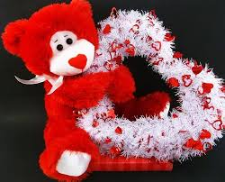


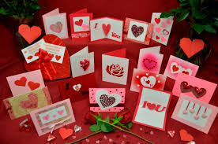
So why do we go to all this fuss over Valentine’s day? Why do people spend lots of money on gifts and cards for one another?
Did you know that Valentine’s Day cards are the 2nd largest selling card , behind Christmas. In the UK over 25 million cards are sold.

Slide 4
Every February, across the country, chocolate, flowers and gifts are exchanged between loved ones, all in the name of St Valentine.
But who is this mysterious saint and why do we celebrate this saint day? The history of Valentine’s Day – and its patron saint – is shrouded in mystery. But we do know that February has long been a month of romance.
St Valentine’s day, as we know it today, contains parts of both Christian and Roman tradition. So who was Saint Valentine and how did he become associated with this ancient rite?

Slide 5
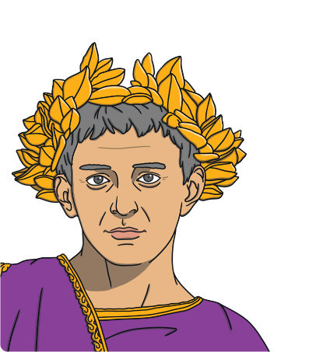
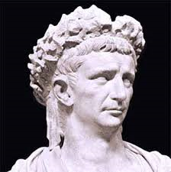
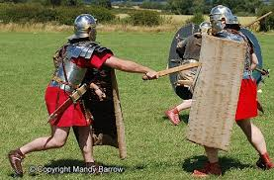

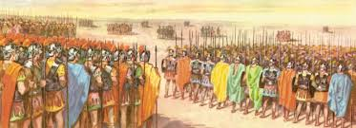
Well, let’s go back to when it all started, hundreds of years ago in Rome, when Claudius 2nd was the Emperor of the Roman Empire.
He liked going to war against other empires so he needed a really big army. Trouble was, all the young, strong men were too busy falling in love and getting married rather than wanting to go and fight for the Roman Army!

Slide 6


That is when Claudius realised that he had to do something about all this “love” business.
Claudius, being the ruler of the country, could do anything he wanted, so he decided to ban people from getting married so that the young men would want to fight in the army.

Slide 7
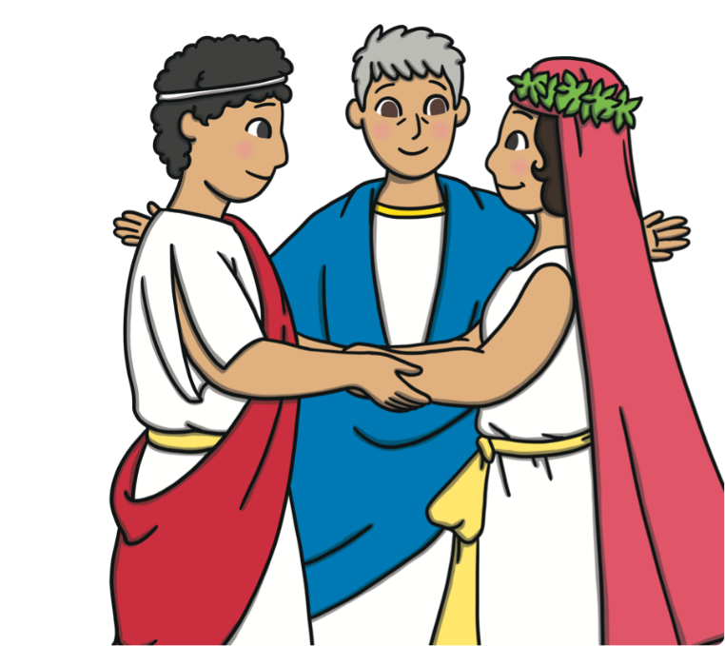
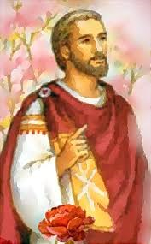
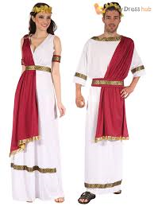
St Valentine was a Catholic priest in Rome. He enjoyed working in his community and was a kind, loving, friendly person who loved to marry young couples and give them God’s blessing. He was horrified when Claudius banned people from marrying and so he carried out secret marriage ceremonies for lots of couples who wished to marry.

Slide 8

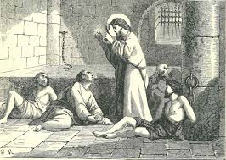
Unfortunately, despite being very careful, Valentine was caught and sent to prison. Claudius the Emperor ordered for him to be beheaded and he was killed on February 14th. This is why we celebrate St. Valentine’s day to remember how loving and caring he was.

Slide 9
According to one legend, Valentine actually sent the first “valentine” greeting himself. While in prison, it is believed that Valentine fell in love with a young girl, who may have been the jailor’s daughter, who visited him. Before his death it is said that he wrote her a letter, which he signed “From your Valentine,” an expression that is still in use today.
It is no surprise that by the Middle Ages, Valentine was one of the most popular saints in England and France.

Slide 10






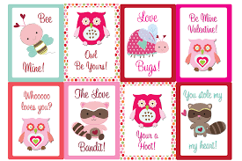
Traditions
In Great Britain, Valentine’s Day began to be popularly celebrated around the 17th century. By the middle of the 18th century, it was common for friends and people in love in all social classes to exchange small tokens of affection or handwritten notes. By the end of the century, printed cards began to replace written letters due to improvements in printing technology. Ready-made cards were an easy way for people to express their emotions. In the 1840s the first commercial Valentine’s cards were produced.

Slide 11

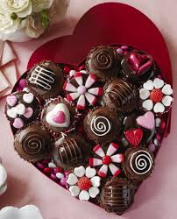
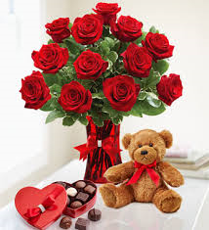
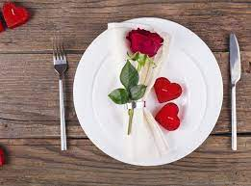
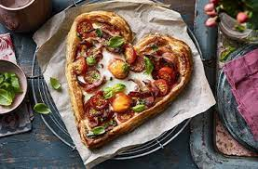
Valentine’s Day is celebrated all over the world. Different countries have different traditions but all of them are rooted in showing and sharing love with friends, families and partners. In the UK, people show they care by sending cards and gifts. Some people take their loved ones out for special treats like meals or to the cinema.

Slide 12



Let us pray.
Dear God, we thank you that we are surrounded by so many people who love and care for us, who treat us kindly and show us respect. Let us remember that you love and care for us just as much, no matter what, and that we can show our love for you by being kind, helpful and caring to everyone. Amen.
The Choir Will Now Sing A Thousand Years
Thank you for listening to our assembly.

Slide 13

Presentation of Valentine Gifts

